Slide 1
Sect. 7.2 Graphing Exponential Functions with Transformations
© Copyright all rights reserved to Homework depot: www.BCMath.ca

Slide 2
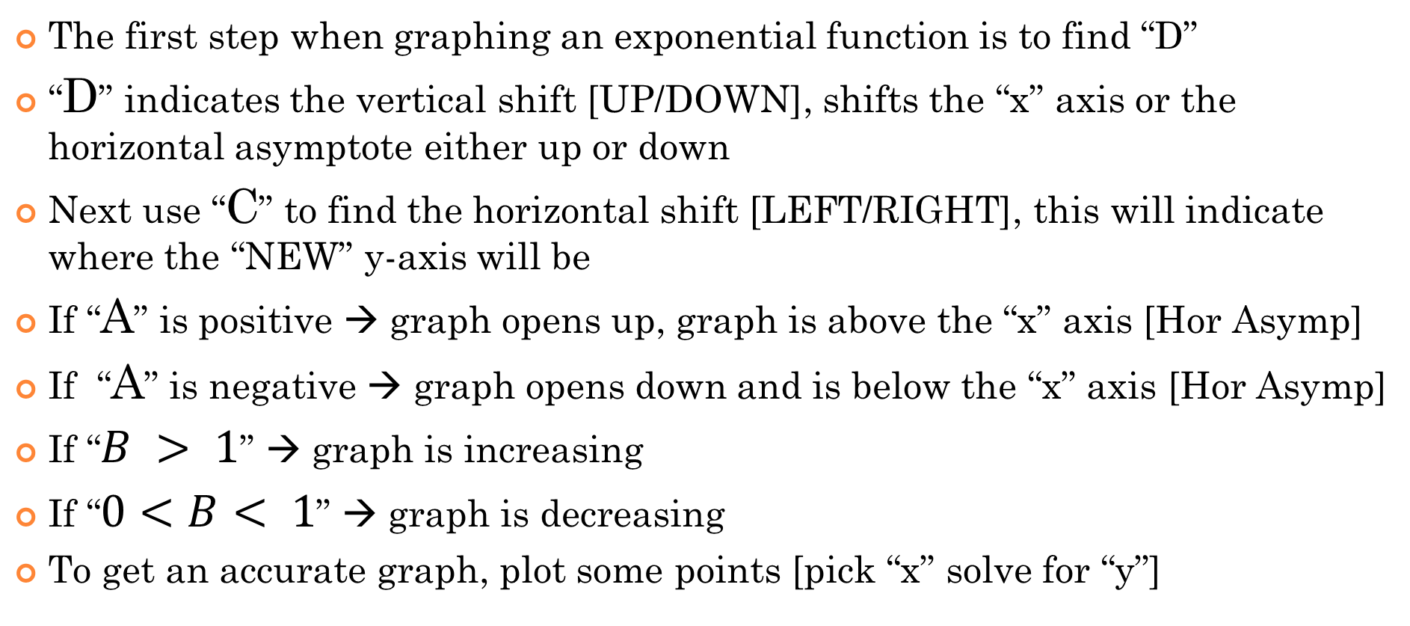
Exponential Functions with Transformations:
The first step when graphing an exponential function is to find “D”
“D” indicates the vertical shift [UP/DOWN], shifts the “x” axis or the horizontal asymptote either up or down
Next use “C” to find the horizontal shift [LEFT/RIGHT], this will indicate where the “NEW” y-axis will be
If “A” is positive → graph opens up, graph is above the “x” axis [Hor Asymp]
If “A” is negative → graph opens down and is below the “x” axis [Hor Asymp]
If “$B > 1$” → graph is increasing
If “$0<B< 1$” → graph is decreasing
To get an accurate graph, plot some points [pick “x” solve for “y”]

Slide 3
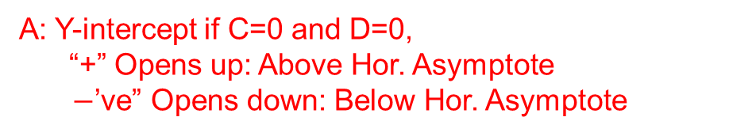
Graphing Exponential Functions with Transformations:
The general formula for an exponential function is in the form:
y
y
A: Y-intercept if C=0 and D=0, “+” Opens up: Above Hor. Asymptote
$−$’ve” Opens down: Below Hor. Asymptote
4
4
3
3
2
B: “Base” of the exponential function, B > 1 – Graph increases AWAY from the horizontal asymptote 0 < B < 1 – Graph decreases CLOSER to the horizontal asymptote
B < 0 – Not an exponential function
2
1
1
x
x
-4
-4
-3
-3
-2
-2
-1
-1
0
0
1
1
2
2
3
3
4
4
-1
-1
-2
-2
-3
-3
C: Horizontal shift: Indicates where the “new” y-axis will be
-4
-4
D: Vertical shift: Indicates the new Horizontal asymptote

Slide 4
Ex: Find the values of “A”, “B”, “C”, & “D, then graph the function:
D = 2, Horizontal Asymptote at y=2
y
C = 3, The y-axis is shifted 3 units Right
12
A = 0.5, since it’s positive, the graph will be above the horizontal asymptotes. It will also intersect the “new” y-axis 0.5 units above the horizontal asymptote
10
8
6
B = 2, since “B” is greater than “1” the graph is will be increasing
4
2
PLOT some points, pick some nice values for “x” and then solve for “Y”
x
-3
-2
-1
0
1
2
3
4
5
6
7
8
9

Slide 5
Practice: Graph the following exp. Functions, indicate the values “a, b, c, and d”, state the domain and range
D = 10, Horizontal Asymptote at y=10
C = -1, The y-axis is shifted 1 units Left
y
A = -1.5, Graph opens down and the y-int was supposed to be -1.5 under the H.A.
12
B = 0.8, The graph is decreasing, plot a few points needed to complete the graph
10
8
6
4
Range is incorrect….. What should it be??
2
x
-3
-2
-1
0
1
2
3
4
5
6
7
8
9

Slide 6
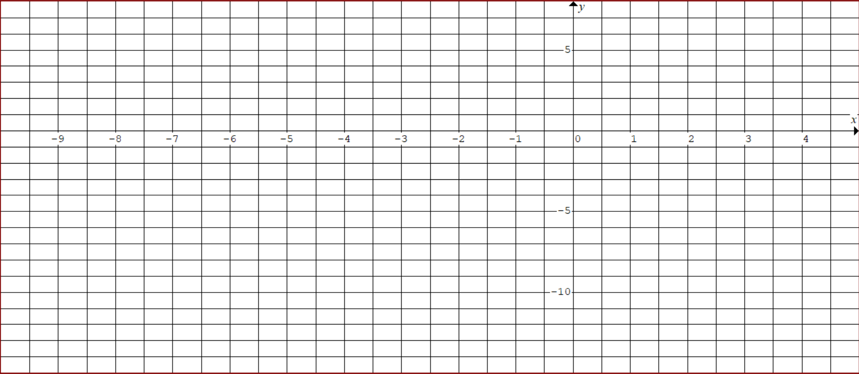
Practice: Graph the following exp. Functions, indicate the values “a, b, c, and d”, state the domain and range
D = 3, Horizontal Asymptote at y=3
C = -2, The y-axis is shifted 2 units Left
PLOT some points, pick some nice values for “x” and then solve for “Y”

Slide 7
Changing the Base to remove coefficient of “x”
If there are negative exponents, turn it into the reciprocal of the base:
A horizontal reflection will turn an increasing graph to a decreasing graph
If the exponent has a coefficient, factor it out and then use it to change the base
The base is changed from “2” to 8

Slide 8

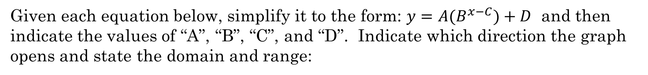





Given each equation below, simplify it to the form: $y=A(B^{x−C})+D$ and then indicate the values of “A”, “B”, “C”, and “D”. Indicate which direction the graph opens and state the domain and range:
The exponent “x” has a coefficient of “3”. Factor this out.
Change the base from “2” to 8, since 2³=8
A=3/2
Opens UP
C=$−2$(left 2)
B=8
Increasing Function
D=$−5$(down 5)
$$A=−1.25$$
Opens Down
The exponent “x” has a coefficient of “0.5”. Factor this out.
$$B=\sqrt{3}$$
Increasing Function
C= $−12$(left 12)
D=$11 (Up 11 )$

Slide 10
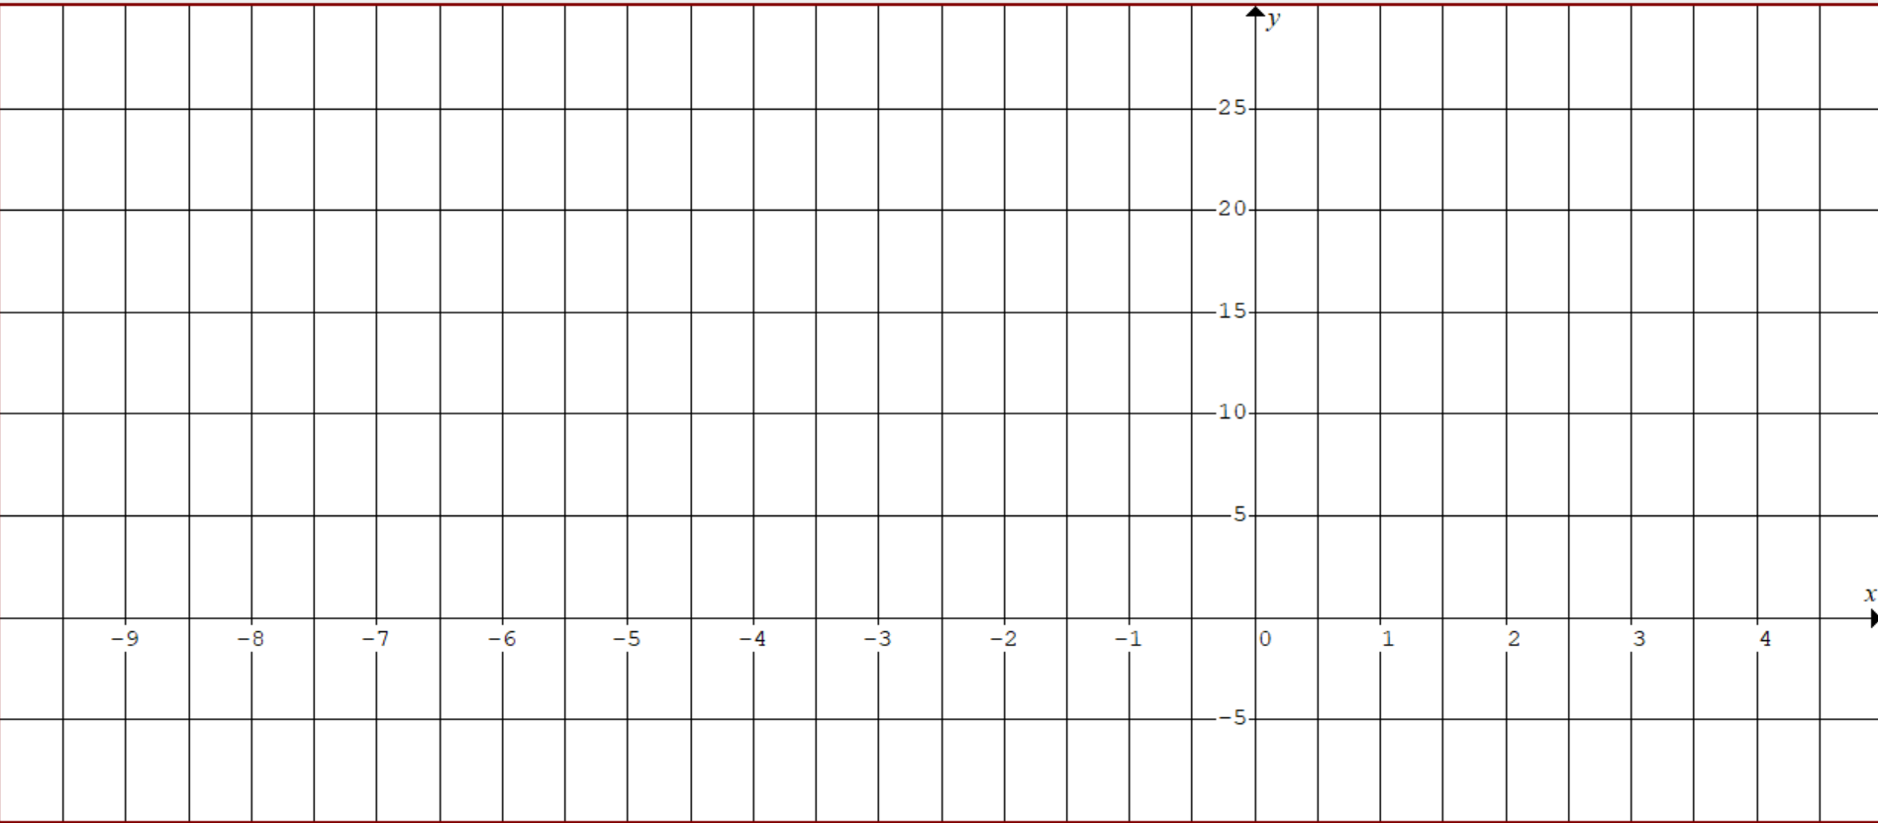
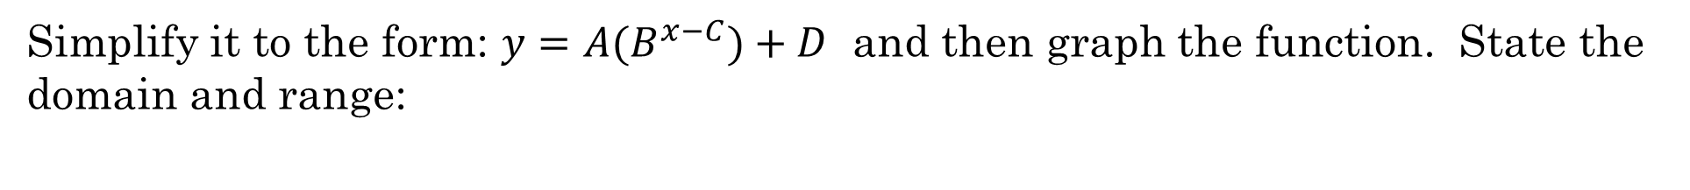
Simplify it to the form: $y=A(B^{x−C})+D$ and then graph the function. State the domain and range:
D = -5, Horizontal Asymptote at y= -5
Factor the “3” in the exponent
C = -2, The y-axis is shifted 2 units Left
A = 2.5, the y-int was supposed to be 2.5 units above the Horizontal asymptote
B = 8, The graph is increasing, plot a few points needed to complete the graph
Range is incorrect….. What should it be??

